Slide 1
Final Project Presentation
Tuhtasinov Murodilla
Dongseo University, 2022

Slide 2
Contents
Introduction
Motivation
Methodology
Goal of the Project
Project Details
Demonstration of the Project
Conclusion

Slide 3
Introduction
A web application based on an online Cab booking System that uses PHP language with MySQL Database.
It has a number of features that will allow users to manage and book cabs online.
The concept of web application is all clear. It is the same as real life scenarios and well implemented on it.
In particular, this online Cab booking System in PHP focuses mainly on booking caps and their management.

Slide 4
Motivation
Making a bridge between clients and drivers.
Easy and safe web app
Implementation PHP

Slide 5
Methodology
PHP
CSS
Windows OS
Web APP
XAMPP for Web Deployment

Slide 6
Goal of the Project
Making web app for admin, drivers and clients.
Developing pick and drop (taxi) service for clients.

Slide 7
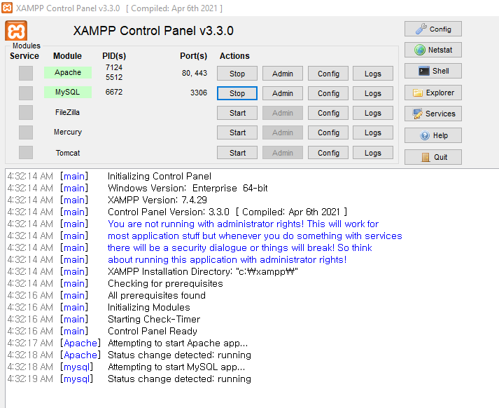
Project Details
XAMPP is a free and open-source cross-platform web server solution stack package developed by Apache Friends, consisting mainly of the Apache HTTP Server, MariaDB database, and interpreters for scripts written in the PHP and Perl programming languages. Since most actual web server deployments use the same components as XAMPP, it makes transitioning from a local test server to a live server possible.

Slide 8
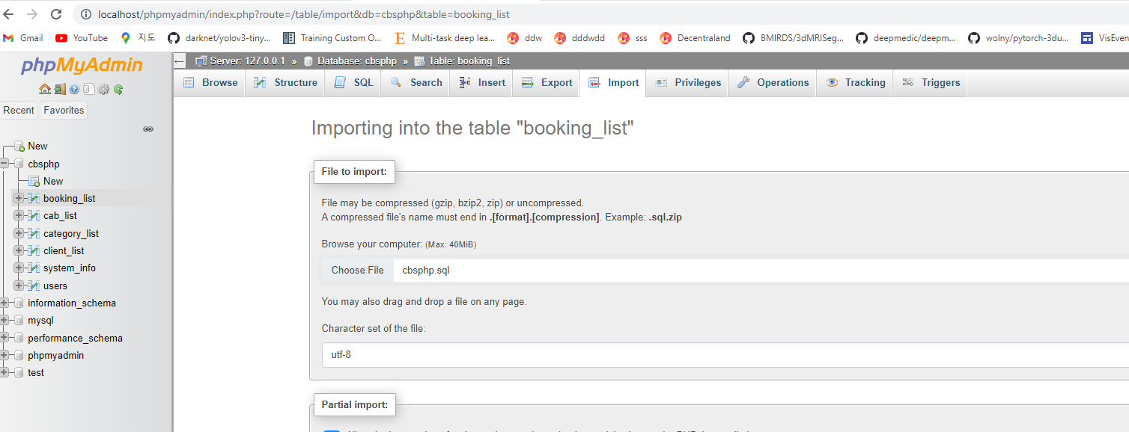
Project Details

Slide 9
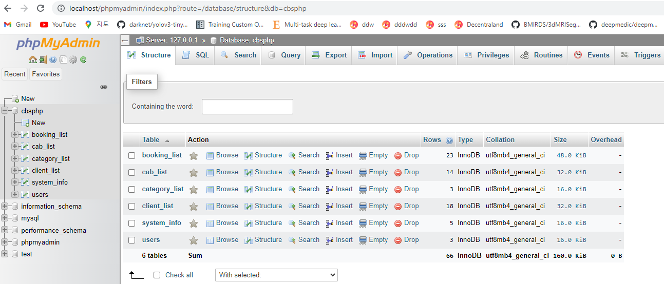
Database View

Slide 10
Project Details
It includes 3 sides:
Admin
Dashboard
Manage category
Cab Management
View bookings
Registered Clients
System Users
Settings
Driver
My Booking List
Client
Home
About Us
Contact
Available Cabs

Slide 11
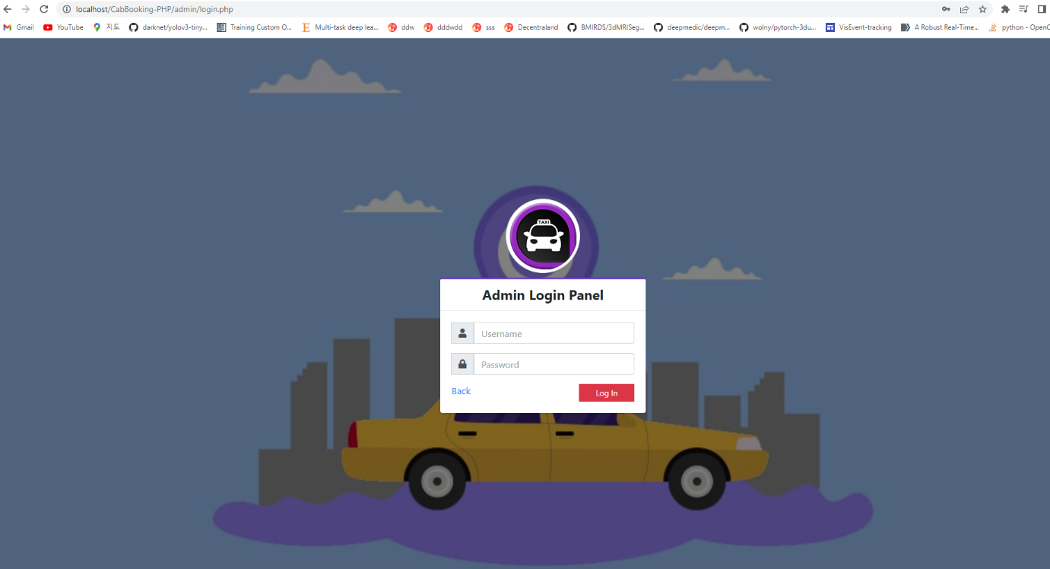
Demonstration of the Project
Admin Page http://localhost/CabBooking-PHP/admin/index.php

Slide 12
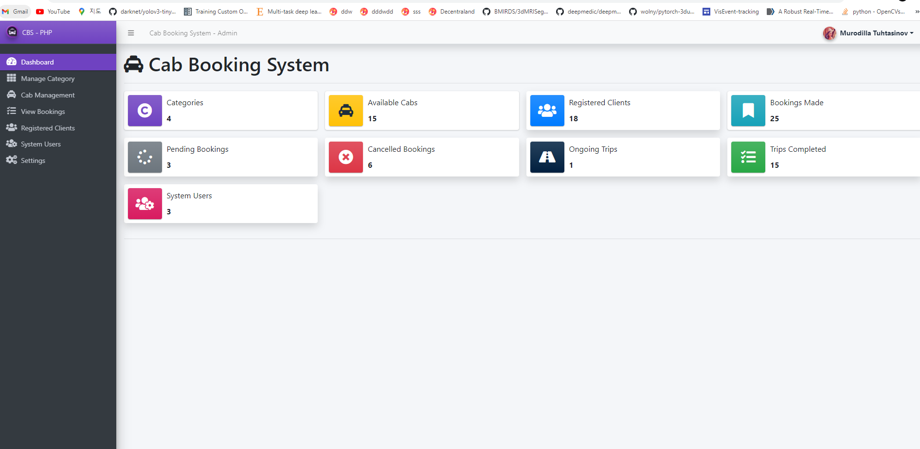
Dashboard Page

Slide 13
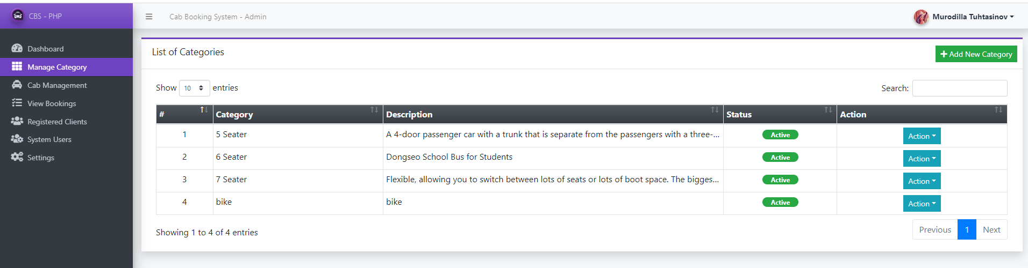
Manage category

Slide 14
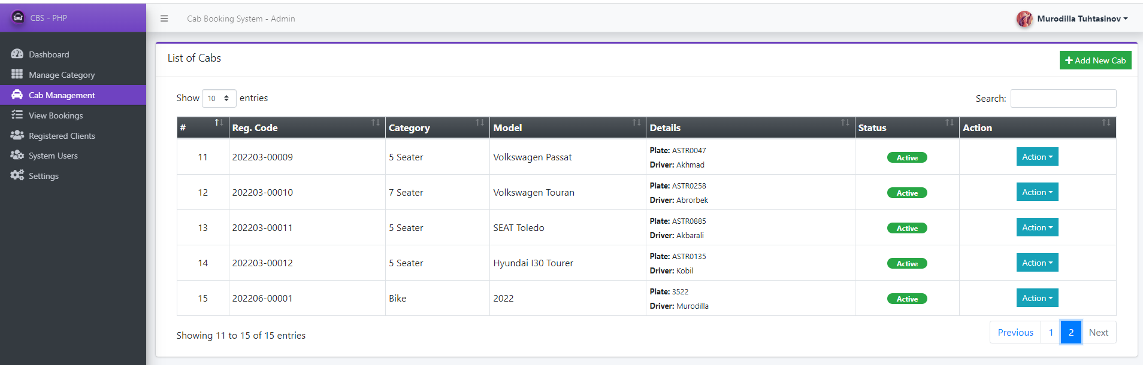
Cab Management

Slide 15
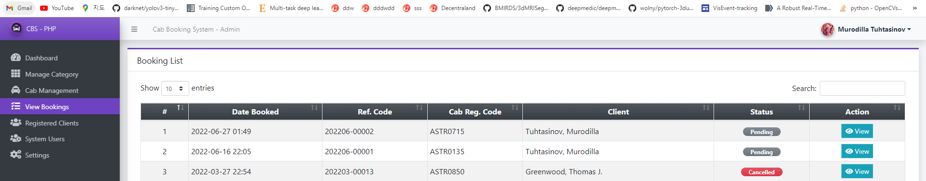
View bookings

Slide 16
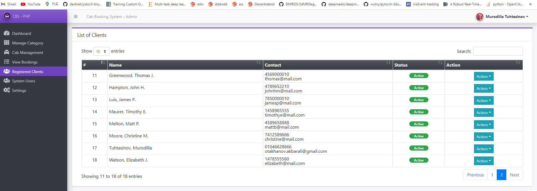
Registered Clients

Slide 17
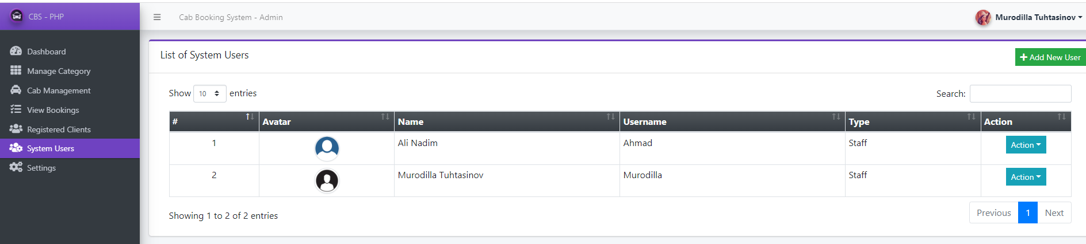
System Users

Slide 18
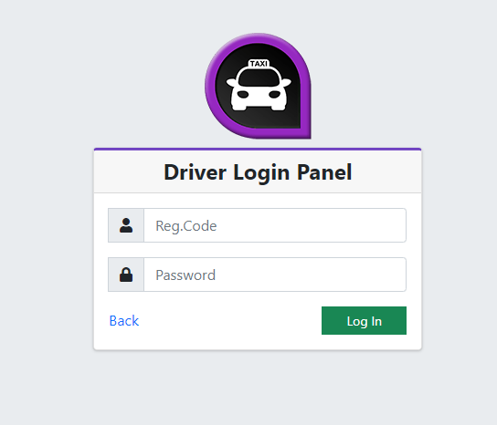
Demonstration of the Project Cont.
Driver Login Page

Slide 19
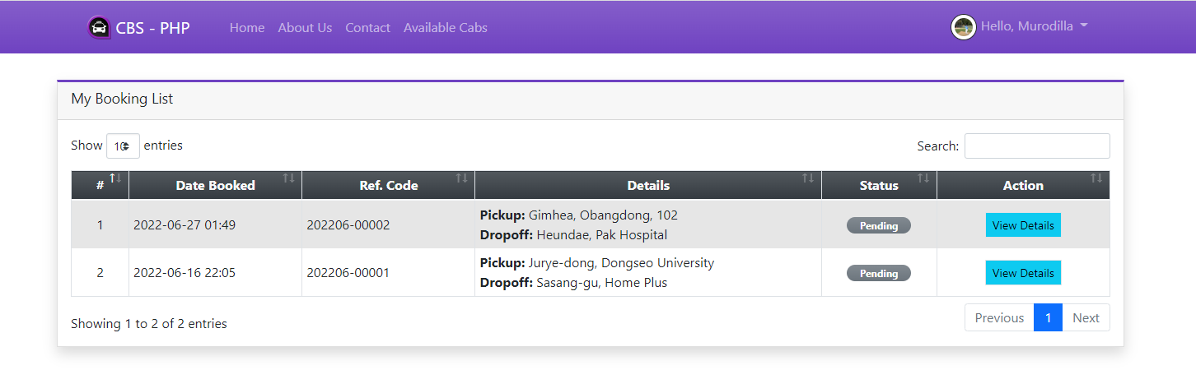
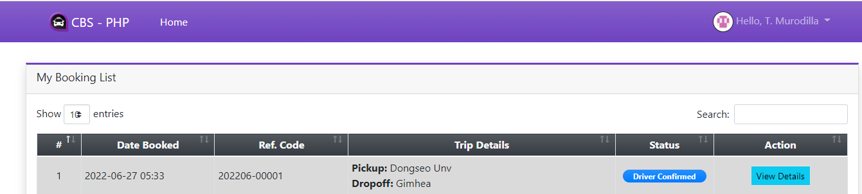
My Booking List

Slide 20
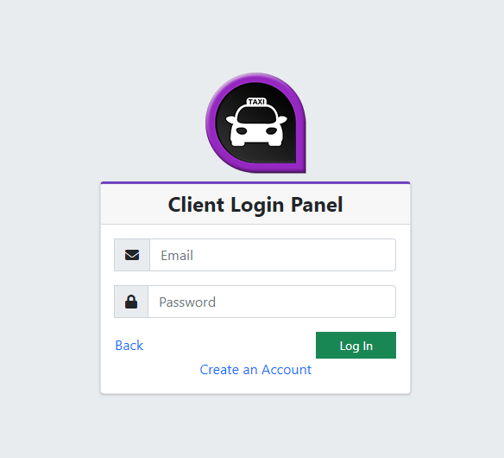
Demonstration of the Project Cont.
Client Login Page

Slide 21
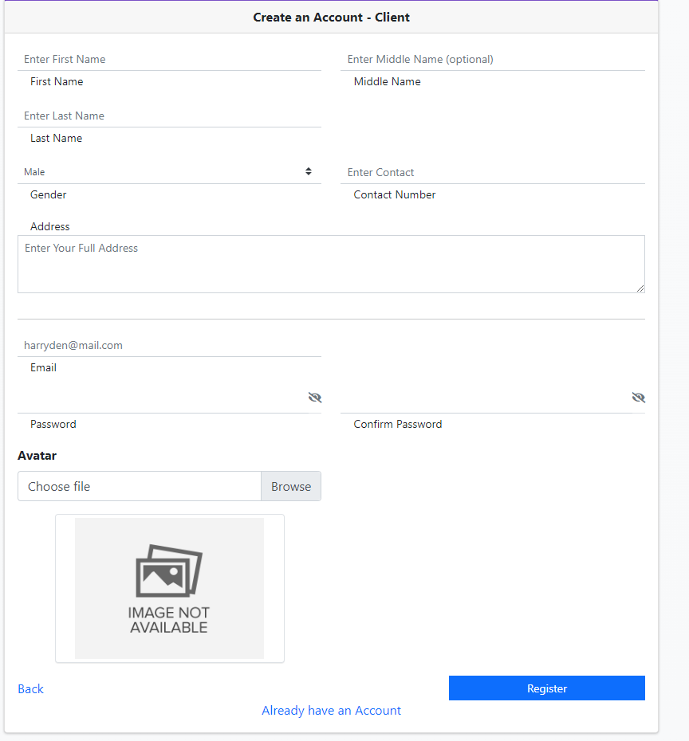
Client Create Account Page

Slide 22
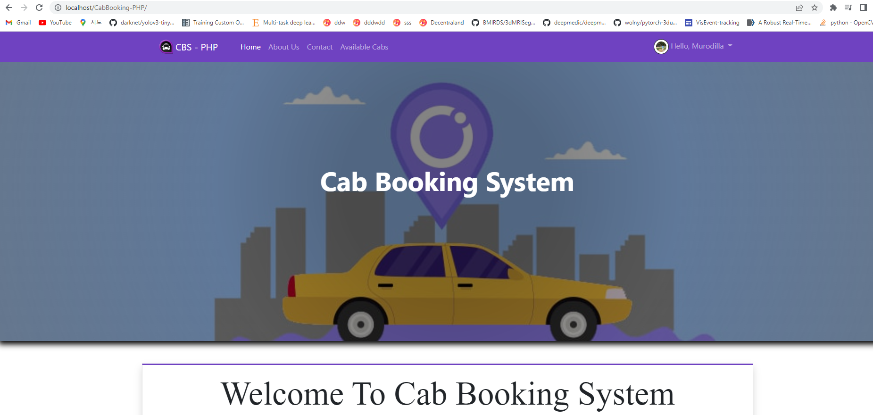
Client Home Page

Slide 23
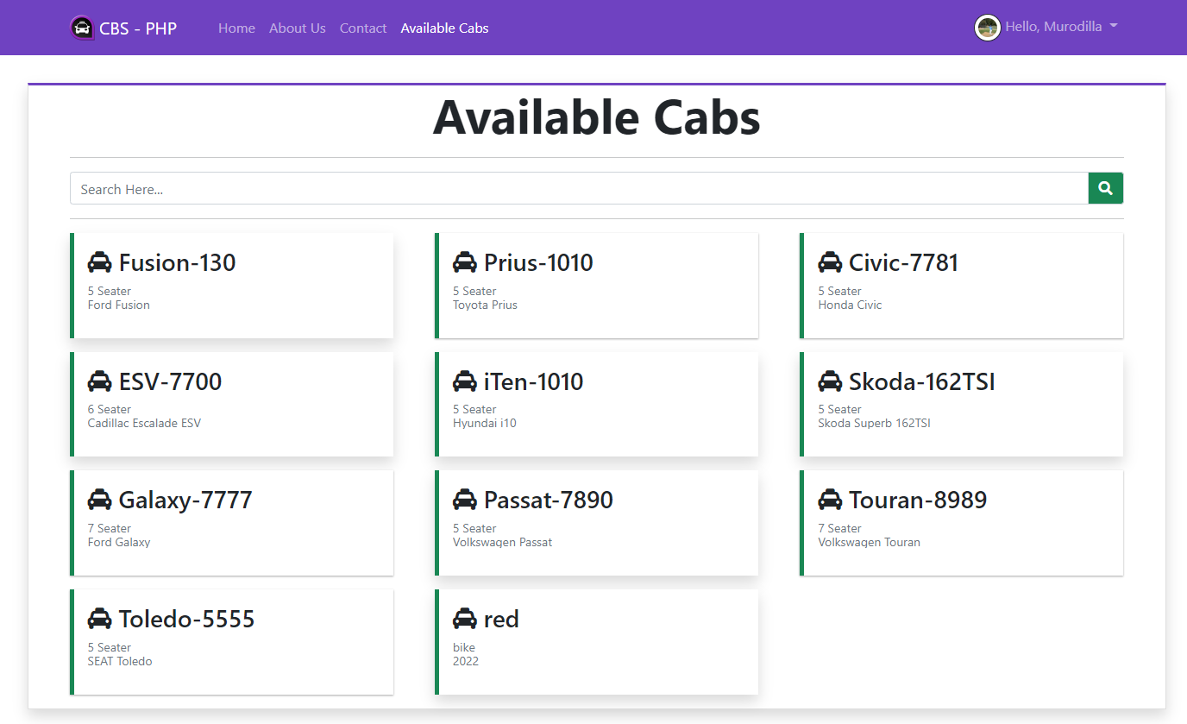
Available Cabs

Slide 24
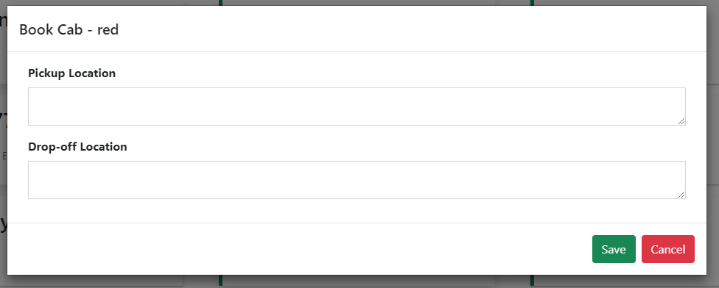
Book Cab Page

Slide 25
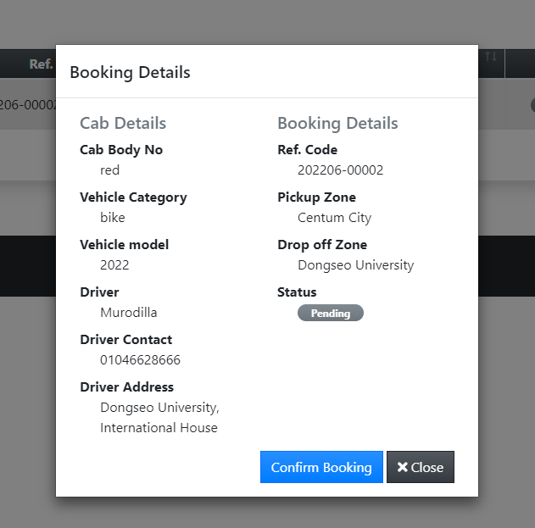
Booking Details Page

Slide 26
Thank you for your attention…
Source code is available via this link: https://github.com/Wreckapp/TaxiCallWebApplication

